Slide 1
The Republican View on American Workforce Coalition Priorities
Presented by Horizon government affairs
February 1, 2024

Slide 2
Joel White President & CEO, Horizon Government Affairs Republican Thought Leader & Strategist
Founded HGA, a bipartisan company health consultancy, in 2007
Worked on aging issues for 20+ years for Congress, multiple clients
50 laws enacted for clients
Dozens of regulatory wins
Hundreds of millions in federal, state funding
Former Staff Director, Ways and Means Health Subcommittee
Wrote nine laws
Created Part D benefit, Part B drug reimbursement, HSAs
Produced more than 100 hearings

Slide 3
Agenda
Understanding the Republican Party
Approaching Each of the 5 Families
What Can Be Done Considering the DC Environment?
Q + A

Slide 4
Understanding the Republican Party

Slide 5
MAGA Ascendent
Notes:
Believer
Go along to prevent attack
Outright opposition
Not policy based – personality based

Slide 6
The Most Important Thing - Elections
Dynamic - Rolling primaries from now to Aug.
Chip Roy’s “name one thing we have done”
Focus on November and winning messages to take the WH and flip the Senate
Elevate Key Issues that differentiate with Biden, Democrats, and that rally the base:
Border Security and Immigration
Tax Cuts
Lower costs/better economy
Crime

Slide 7
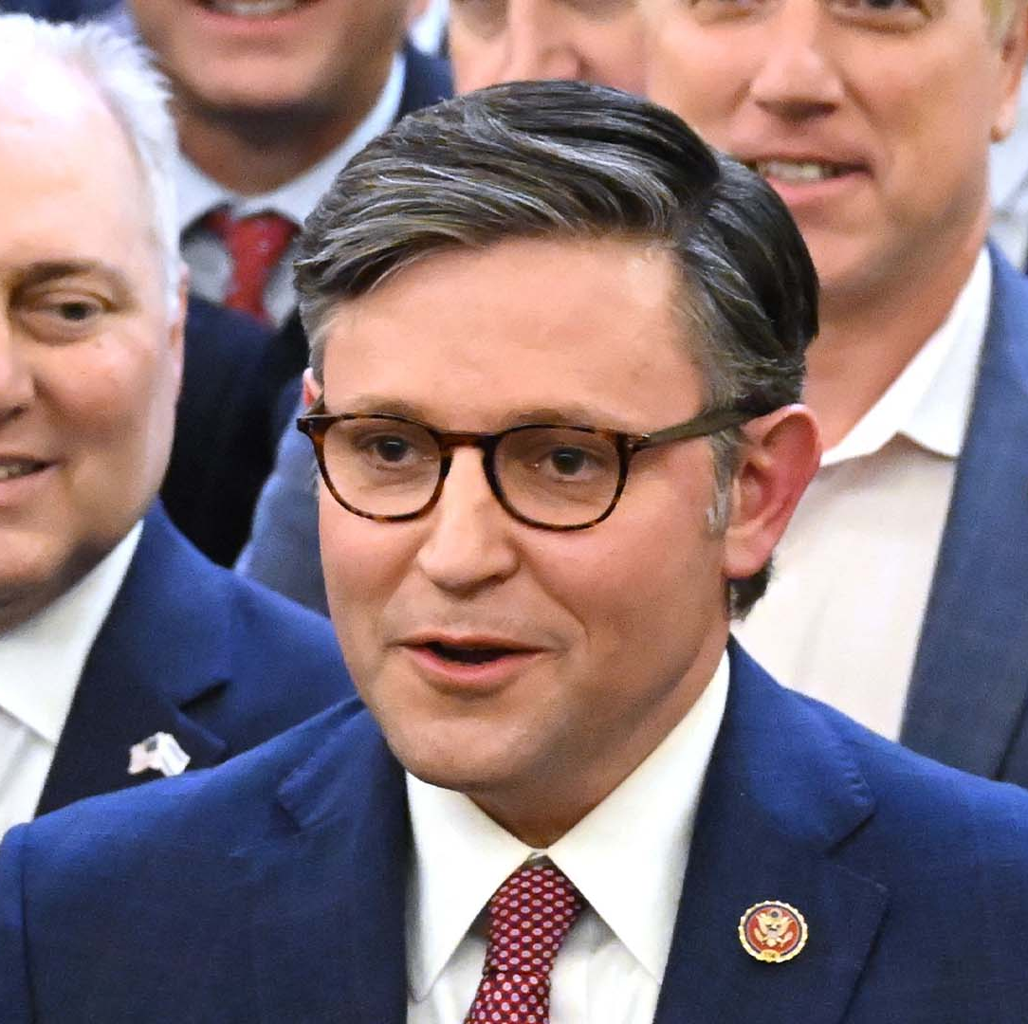
WHO IS SPEAKER JOHNSON?
Socially and fiscally very conservative, Trump inner-circle, MAGA/Freedom Caucus wing of party
Focused on border security, immigration, and reining in federal spending
Election has electrified Senate MAGA Republicans (Cotton, Marshall, Tuberville, etc.), creating issues for McConnell

Slide 8
Key Priorities
Reform immigration, enhance border security
Cap spending and balance the budget within 10 years
End “Woke” policies in federal government. Hold bureaucrats accountable
Protect sanctity of life
Lower taxes, expand economic growth
Fight crime and fentanyl
Notes:
Up to $1.2 trillion in green tax write-offs for billion-dollar companies. • $709 billion in student loan giveaway, which forces 87 percent of Americans without student loans to pay off the remaining 13 percent. • Over $1 billion to the Department of Homeland Security to police “political extremism” • $385 million for green energy subsidies at the State Department • $225 million to programs supporting Palestinians in the West Bank and Gaza

Slide 9
The 5 Families
The Republican Party is not unified – really two parties (MAGA and everyone else)
But within the House GOP, there are currently 5 factions:
Problem Solvers Caucus (bipartisan moderates – get stuff done)
Republican Governance Group (moderate, swing districts)
Republican Main Street Caucus (moderate, business focused)
Republican Study Committee (conservative)
House Freedom Caucus (ultra conservative)
Some overlap across factions

Slide 10
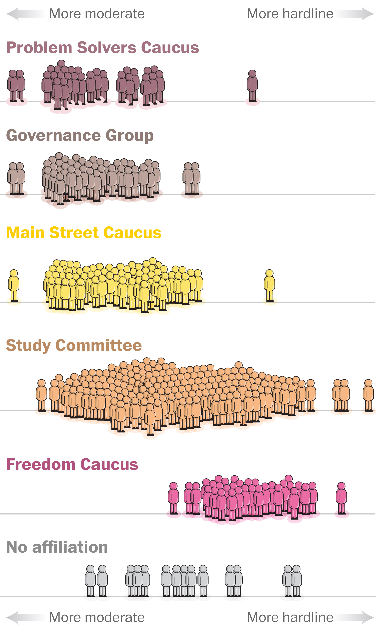
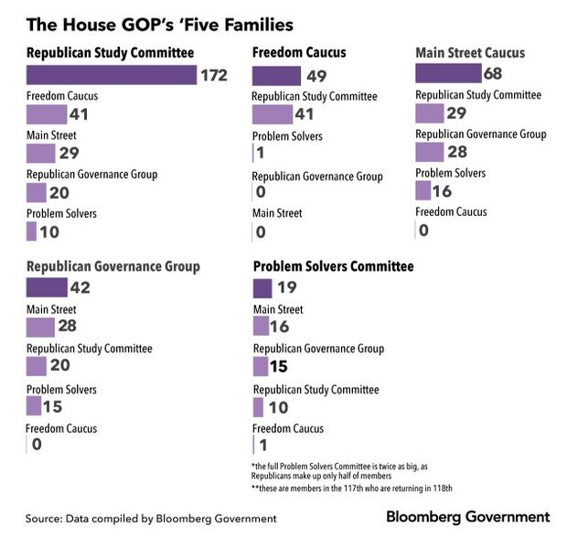

Slide 11
Approaching Each of the 5 Families
Knowing the Dialect of your target audience

Slide 12
How do the families view issues?
Problem Solvers Caucus:
Why is this a bipartisan issue?
Intersection with new economy, tech, big players
Republican Governance Group:
Does this appeal to swing voters? Suburban districts?
Is this a smart, fiscally conservative differentiator?
Republican Main Street Caucus:
How does this help business?
Why does this appeal to swing voters?
Republican Study Committee:
Is this fiscally conservative? Empowering?
Does this promote private sector jobs?
House Freedom Caucus:
Does this increase or reduce spending? the deficit?
Is there waste? Is it woke?
Notes:
Fitzpatrick
Joyce
Dusty Johnson
Kevin Hern
Scott Perry

Slide 13
What Can Be Done
Education, recognition, allies + Champions

Slide 14
OAA Reauthorization + SCSEP Funding
Funding is a problem now and in the future
The Committee provides no funding for the CSEP program. The Committee notes that the last comprehensive evaluation of the program found that it led to unsubsidized employment for less than half of program participants available for employment with worse outcomes for participants with a disability, older adults, and participants with lower levels of education.
…but can be overcome

Slide 15
Coordinated Outreach + Education
Share political and policy intel to best position the American Workforce Coalition and its members (you)
Engage directly with Capitol Hill, focusing on key committees of jurisdiction and geographies where you operate SCSEP or related programs
Meet with key Leaders, including the people cutting you
Focus on in state meetings
Senate is your defensive wall (Collins, Murray)
Use consistent messaging and relay feedback to adjust for Republican or Democrat offices (and leverage the insights here on the nuances in messaging for the 5 families in the Republican Party)
Define success and needed reforms
Notes:
For example, on behalf of CWI, Horizon has reached out to key Republicans and the 12 states where Center for Workforce Inclusion’s current SCSEP programs operate, targeting Republicans in:
Alabama
Illinois
Indiana
Massachusetts
Maryland
Minnesota
Mississippi
North Carolina
New York
Tennessee
Texas
Wisconsin

Slide 16
Questions + Feedback

